Slide 1

Green Pace
Security Policy Presentation
Developer: [Alexander Egelston]
[Secure Coding Testing Methods and Vulnerabilities]

Slide 2

OVERVIEW: DEFENSE IN DEPTH
This is an illustration on defense in depth, a vital concept centered around having multiple layers of security acting as additional mitigating safety features if a breach does occur.

Slide 3
THREATS MATRIX
Likely [Threats that are more likely to occur.] | Priority [Threats with a high level of importance.]
Low priority [Threats with a low level of importance.] | Unlikely [Threats that are less likely to occur.]
This matrix breaks down the different categories of cyber threats. Each type of threat has an associated level of importance and likelihood.

Slide 4
10 PRINCIPLES
Validate Input
Heed Compiler Warnings
Architect and Design for Security Policies
Keep it Simple
Default Deny
Adhere to the Principle of Least Privilege
Sanitize Data Sent to Other Systems
Practice Defense in Depth
Use Effective Quality Assurance Techniques
Adopt a Secure Coding Standard

Slide 5
CODING STANDARDS
Do not cast to an out-of-range enumeration value
Use valid references, pointers, and iterators to reference elements of a container
Do not attempt to create a std::string from a null pointer
Do not store already-owned pointer value in an unrelated smart pointer
Properly deallocate dynamically allocated resources
Use a static assertion to test the value of a constant expression
Handle all exceptions thrown before main() begins executing
Do not alternately input and output from a file stream without an intervening positioning call
Do not invoke virtual functions from constructors or destructors
Value returning functions must return a value from all exit paths

Slide 6
ENCRYPTION POLICIES
Encryption in Flight: Encryption in flight is when data being transmitted is encrypted before it is received. The data is decrypted when it arrives at its intended receiver. This allows the data to be transmitted remotely and unsure successful encryption during transportation that verifies the data was not compromised.
Encryption at rest: Encryption at rest allows the user to decrypt the data on their own storage device without needing to worry about the data becoming compromised if the device is stolen or hacked. Without the decryption key, unintended users will not be able to decrypt the data.
Encryption in use: Encryption in use is a method of encryption that requires constant reverification of the user’s credentials. This reverifies that the user is who they are presenting as anytime new data is accessed or an action is taken on the software.

Slide 7
TRIPLE-A POLICIES
Authentication: When a user attempts to access a system they are prompted to verify their identity. This may include logging in with a user ID and password as well as second factor authentication.
Authorization: Verifying the user is authorized to access certain parts or functions of a system is authorization. For example in a CRUD database, a user might need authorization verification when creating, reading, updating, or deleting data.
Accounting: The tracking of any actions taken by all users on a system makes up accounting. This allows Admins to see a digital trail of what is being accessed in the case of needing further information on user activity.

Slide 8
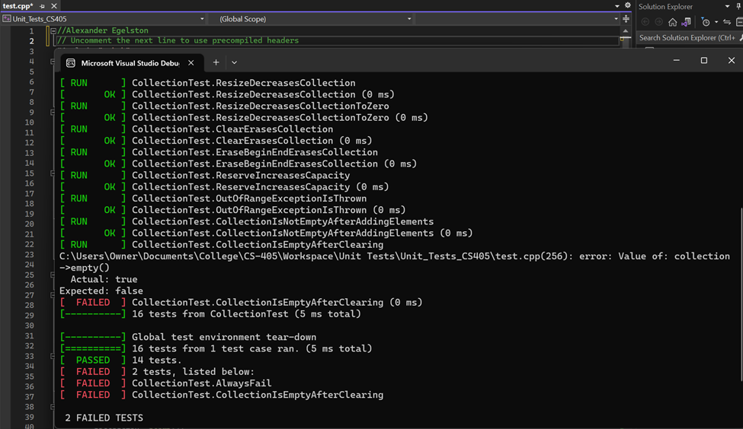
Unit Testing
In the process of debugging the unit test code, I took a systematic approach to identify and resolve various types of bugs. Initially, the tests were not correctly evaluating whether the collection was empty or not, which lead to false positives. The CanAddToEmptyVector test was corrected to add a value to the empty collection before verifying that it was no longer empty.
Additionally, the CollectionIsEmptyAfterClearing test was modified to add entries to the collection, clear it (where before the clearing of the collection had been accidentally skipped), and check if it is indeed empty. These changes ensure that the tests accurately validate the expected behavior, making the debugging process thorough and effective.

Slide 9

AUTOMATION SUMMARY

Slide 10
TOOLS
The DevSecOps pipeline is the secure coding method loop for maintaining code that is efficient and secure for the users of the system.
In the context of the diagram tools will remain in steps associated with what they are needed for such as build tools like Jenkins being called for in the build step, functional testing tools like Selenium being called for in the Verify and Test step, and tools like firewalls being called for in the Respond step. The only steps within the Automation Summary diagram that do not contain security automation are the Design and Build steps as these are where developers are making decisions on how the system should be developed and cannot be completed solely through automation. The Build step is where developers should utilize the compiler and convert the source code into executable code for the system.

Slide 11
RISKS AND BENEFITS
The benefits of taking immediate action are reduction of impact, mitigating secondary effects for users, and preventing further compromise of the system.
The risks of waiting to take action are the escalation of damage to the system, data corruption, regulation fines, damage to reputation, and legal consequences.
The risks of the strategy shown in the automation summary are a false sense of security due to overreliance on automation tools, potential for system analysts to not have necessary skills to respond to complex issues in a system largely built with automation tools, and the potential for some threats to go unnoticed with an excessive amount of alerts overwhelming security teams.

Slide 12
RECOMMENDATIONS
Given it is a mostly human process there is room for error in every step. In the Assessment and Plan step it is possible that not all emerging threats are identified which in turn would lead to less considerations in the design of the system. Inadequate security testing via a lack of penetration testing, vulnerability assessments, and security code reviews could leave the system open to attacks from several angles. Depending on the tools and software used for monitoring of the system security, suspicious activities or potential breaches may go by unnoticed.

Slide 13
CONCLUSIONS
One standard that can largely improve system security is the Zero-Trust policy. In this policy no device or user is trusted and must be verified during every attempt to access the system. In addition to this standard, developers should also adhere to the NIST Cybersecurity Framework. This framework provides general guidelines for improving the cybersecurity risk management levels of systems being monitored/developed.

Slide 14
REFERENCES
Admin. (2022, May 4). 10 secure coding practices you can implement now. Code Signing Store. https://codesigningstore.com/secure-coding-practices-to-implement
Personalization in the age of GDPR. Fresh Relevance. (2022, September 7). https://www.freshrelevance.com/resources/gdpr-personalization/
What is the exploration vs exploitation trade off in reinforcement learning?. Scribbr. (2023, July 14). https://www.scribbr.com/frequently-asked-questions/what-is-the-exploration-vs-exploitation-trade-off-in-reinforcement-learning/

